Slide 1
Introduction to Reverse Engineering
Ali Ghaffarian

Slide 2
Me?
Interested in
Operating Systems
Networking
CTF
Active Member of FlagMotori
Network Forensics

Slide 3
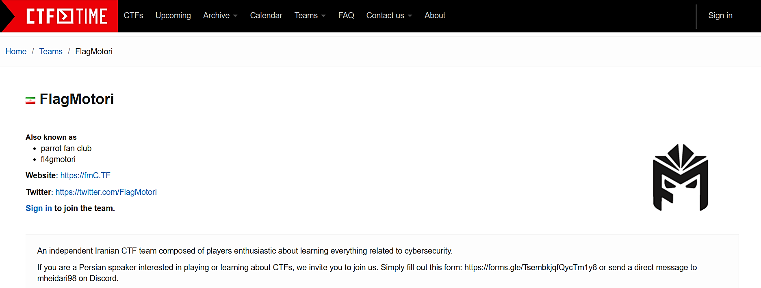

Slide 4
Table of Contents
CTF?
CTF Categories
Introduction to Binary Analysis
Instances
Types of Analysis
Tools
Demo
Binary Analysis in More Depth

Slide 6
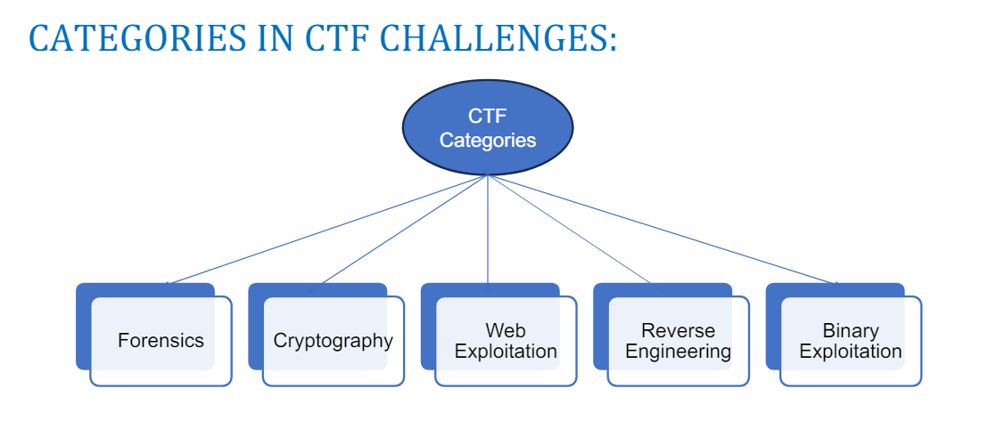
Categories

Slide 7
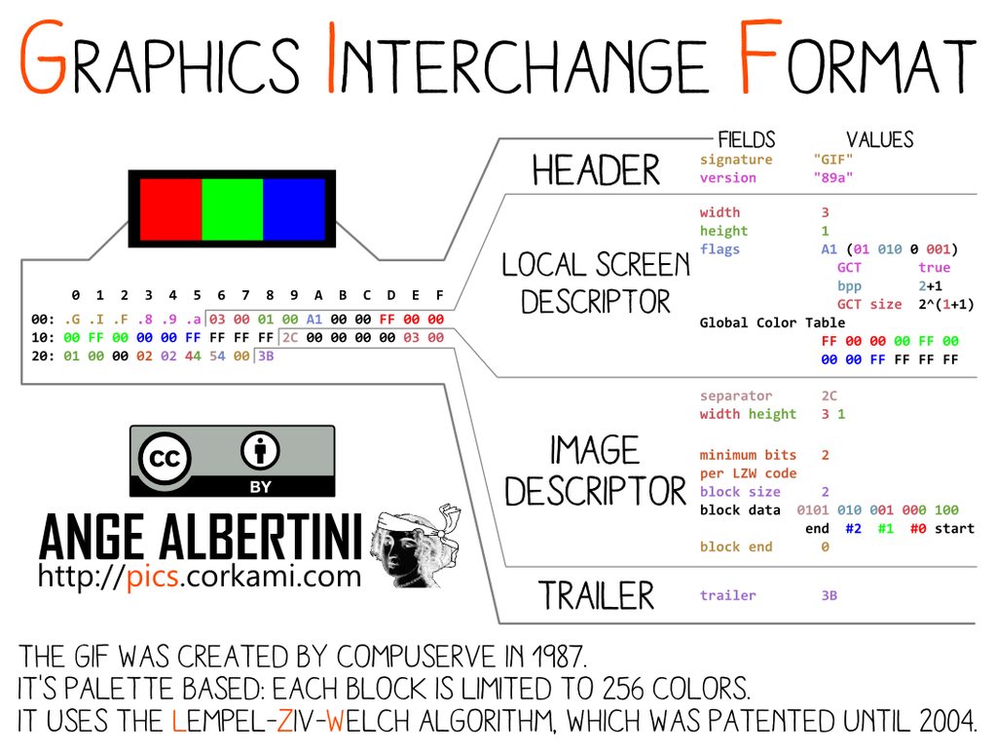
Forensics

Slide 8
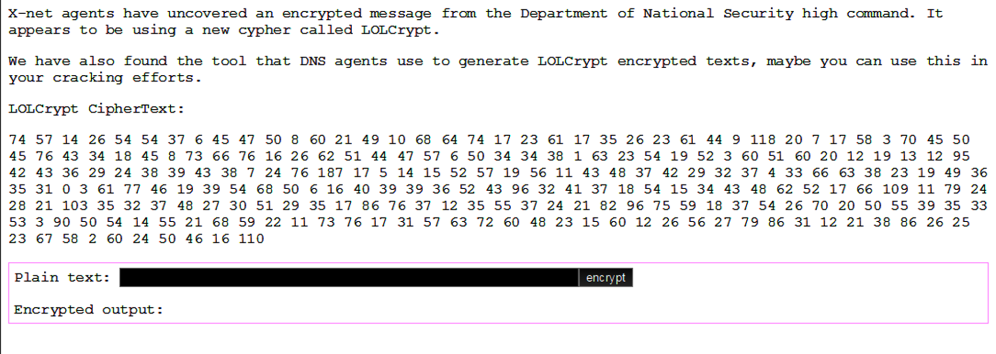
Cryptography

Slide 9
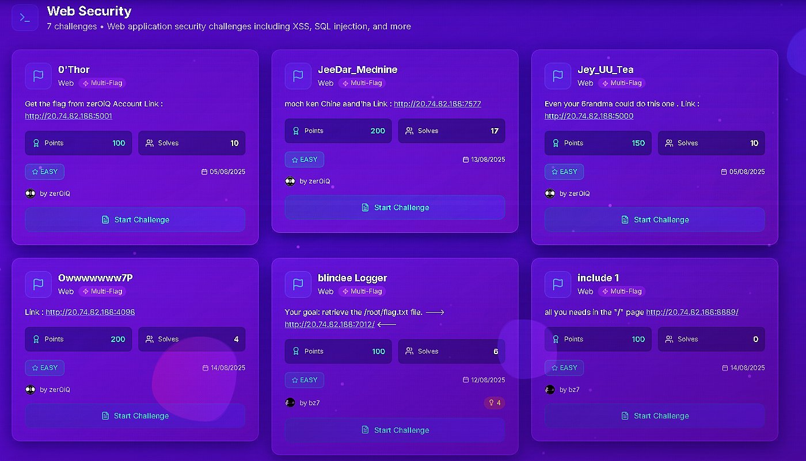
Web Security

Slide 10
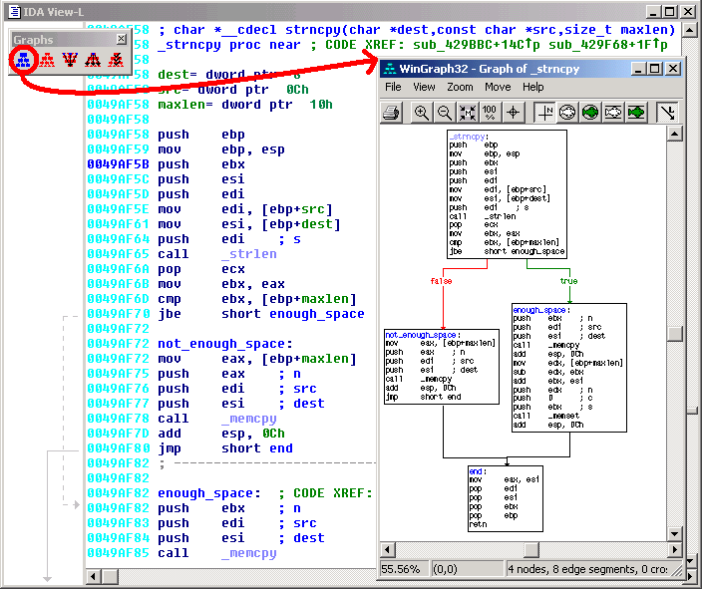
Reverse Engineering

Slide 11
Binary Exploitation
Exploitation Attempt
Attacker
software
Secret information

Slide 12
Introduction to Binary Analysis
Make it do what you want!

Slide 13
Instances
Game Hacking
Malware Analysis
Cracking

Slide 14
Types of Analysis
Static vs Dynamic

Slide 15
Static Analysis

Slide 16
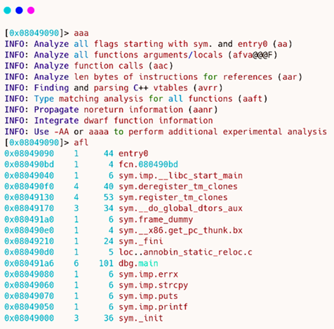
Dynamic Analysis
Debugging

Slide 17
Tools
IDA
Ghidra
Dogbolt.org

Slide 18
Demo

Slide 19
The Compilation Process
Compile
Assemble
Link
#include <stdio.h>
int main(){
printf("hello world!\n");
}

Slide 20
Compile hello_world.s
lea rax, .LC0[rip]
mov rcx, rax
call puts
mov eax, 0
add rsp, 32
pop rbp
ret

Slide 21
Assemble hello_world.o
Contents of section .text:
0000 554889e5 4883ec20 e8000000 00488d05 UH..H.. .....H..
0010 00000000 4889c1e8 00000000 b8000000 ....H...........
0020 004883c4 205dc390 90909090 90909090 .H.. ]..........

Slide 22
Link
$dir
10/20/2025 05:38 PM 128,829 hello_world.exe
10/17/2025 05:55 PM 66 hello_world.c
10/20/2025 05:36 PM 882 hello_world.o
10/20/2025 05:34 PM 571 hello_world.s

Slide 23
Know Your Compiler!

Slide 24
So Much Added Code!
int WinMainCRTStartup(void);
int mainCRTStartup(void);
int32_t atexit(void (*func)(void));
int64_t __gcc_register_frame(void);
void __gcc_deregister_frame(void) __pure;
int64_t main(void);

Slide 25
Find the Relevant Code
int64_t main() {
__main();
puts("hello world!");
return 0;
}

Slide 26
Thanks!
github.com/AliGhaffarian/QUT-reverse-engineering-competition

